Slide 1

Chapter 4
E-environment
Part -1

Slide 2

Learning outcomes
Identify the different elements of an organisation’s macro-environment that impact on an organisation’s digital business and digital marketing strategy
Assess the impact of legal, privacy and ethical constraints or opportunities on a company
Assess the role of macro-economic factors such as economics, governmental digital business policies, taxation and legal constraints

Slide 3
Management issues
What are the constraints such as legal issues which should be taken into account when developing and implementing a digital business strategy?
How can trust and privacy be assured for the customer while seeking to achieve marketing objectives of customer acquisition and retention?
Assessment of the business relevance of technological innovation.

Slide 4
Importance of Macro and Micro environments
To start and manage any (digital) business, the environment has to be understood and analysed.
Macro-environment: Elements outside of the organisation that indirectly influence its operations
Micro-environment: Internal factors that directly influence the organisations, such as suppliers, competitors, intermediaries and customers.

Slide 5
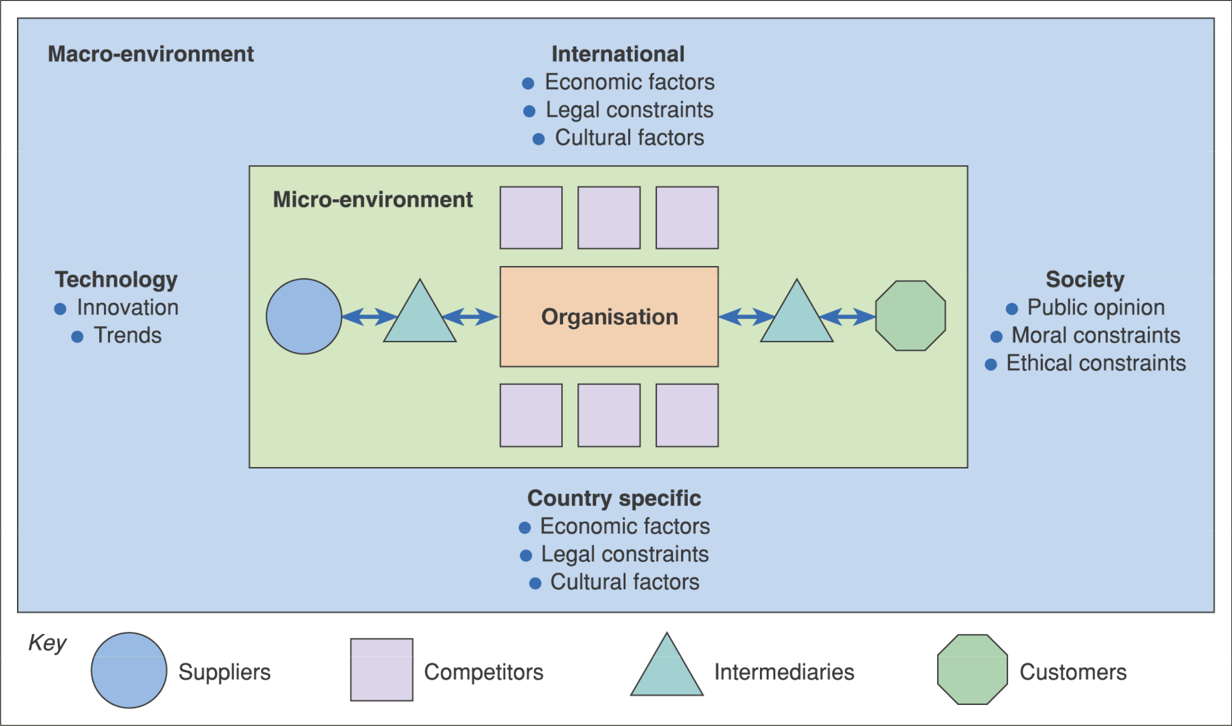
Environment
Environmental Scanning: The process of continuously monitoring the environment and events and responding accordingly.

Slide 6
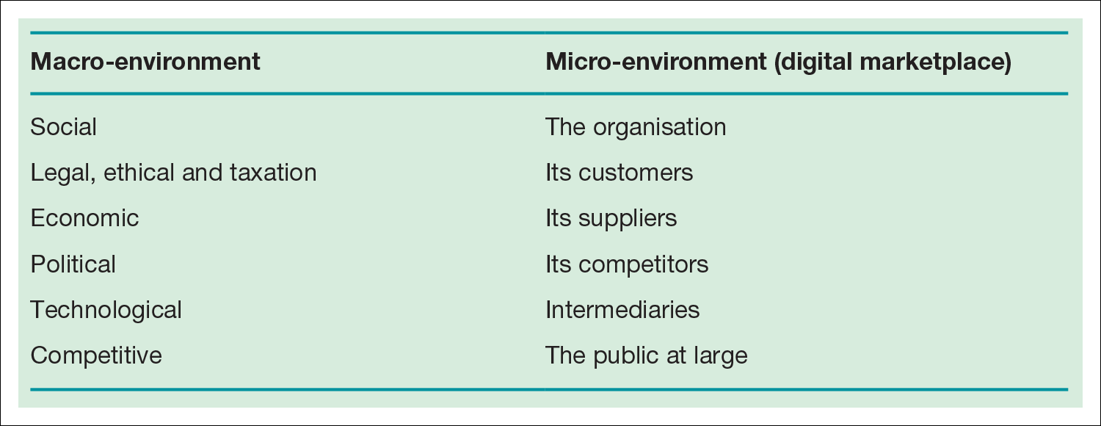
Table 4.1 Factors in the macro-​and micro-​environment of an organisation

Slide 7
Activity 4.1 Introduction to social, legal and ethical issues
List all the social, legal and ethical issues that the manager of a sell-side e-commerce website needs to consider to avoid damaging relationships with users of his or her site or which may leave the company facing prosecution.
You can base your answer on current issues which may concern you, your friends or your family when accessing a website.

Slide 8
Activity answer
Cookies – laws and consumer perception on placing these
Are we limiting access to information from certain sections of society (social exclusion)?
Privacy of personal information entered on a website
Sending unsolicited e-mail
Replying promptly to e-mail
Copyright
Site content and promotional offers/adverts are in keeping with the different laws in different countries
Providing text, graphics and personality in keeping with social mores of different countries.

Slide 9
SLEPT factors
Macro-environment
Social - Include the influence of consumer perceptions in determining usage of the Internet for different activities
Legal - Determine the method by which products can be promoted and sold online. Governments set the legal rules
Economic - Variations in economic performance in different countries and regions affect spending patterns and international trade
Political - National governments and transnational organisations have an important role in determining the future adoption and control of the Internet and the rules by which it is governed.
Technological - Changes in the technology offer new opportunities for the way products can be marketed.

Slide 10
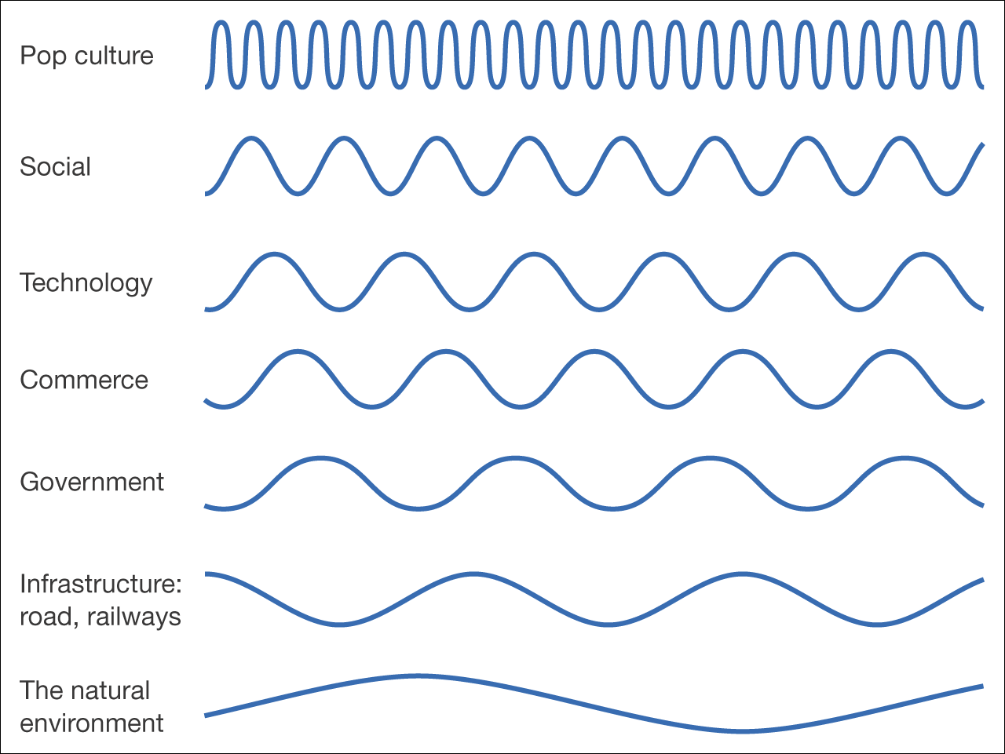
Figure 4.1 ‘Waves of change’ – different timescales for change in the environment

Slide 11
Four main acts, directives and laws that e-commerce companies must comply with:
The Electronic Commerce (EC Directive) Regulations 2002
The General Data Protection Regulations (GDPR)
The distance Selling Act 2000
ICO Cookie Law

Slide 12
Social Factors
People with different attitudes and opinions to certain ideas, products, services and communication
Culture
Demographics such as age and gender
Social lifestyles
Domestic structures
Affluence/wealth
Religion

Slide 13
Social Factors
ZMOT – pre-purchase research, based on reviews etc.
FMOT – Decision making when customer is at the shelf to buy a product/service
SMOT – When customer takes the product, use it and forms an opinion about it.
Showrooming
When consumers decide to purchase a product online after looking at it in a physical retailer’s store. This usually involves using a mobile device to see if they can buy it cheaper online

Slide 14
Social Factors – M-Shoppers
M-Shopper Segmentation (Columbia Business School and Aimia, 2013)
Exploiters(6%)
Planned to buy online and opted for lowest price. Other than price savings, such as free shipping, online rewards. More likely to be females and have a bit lower incomes
Savvys(13%)
Likely to purchase in a retail store, unlike exploiters, but planned to showrooming and using mobiles for price comparison. More likely under 30s and males.
Price-sensitives(19%)
High price-sensitives, never purchase offline, unless persuaded by a good deal. Likely over 29s, male or female
Traditionalists(30%),
Committed to purchasing in-store, call loved ones to get their advice. More likely to be females, over 55s
Experience-seekers(32%)
Great believers of buying in-store, even if they find cheaper online. More likely to be under 30s.

Slide 15
Legal and Ethical Factors
These determine the method by which products can be promoted and sold online.
Gov, on behalf of society, seek to safeguard individual rights, privacy etc.
Key legal factors include
GDPR(General Data Protection Regulation) from 25-05-2018
Disability and Discrimination law
Brand and trademark protection
Intellectual property rights
Contract law

Slide 16
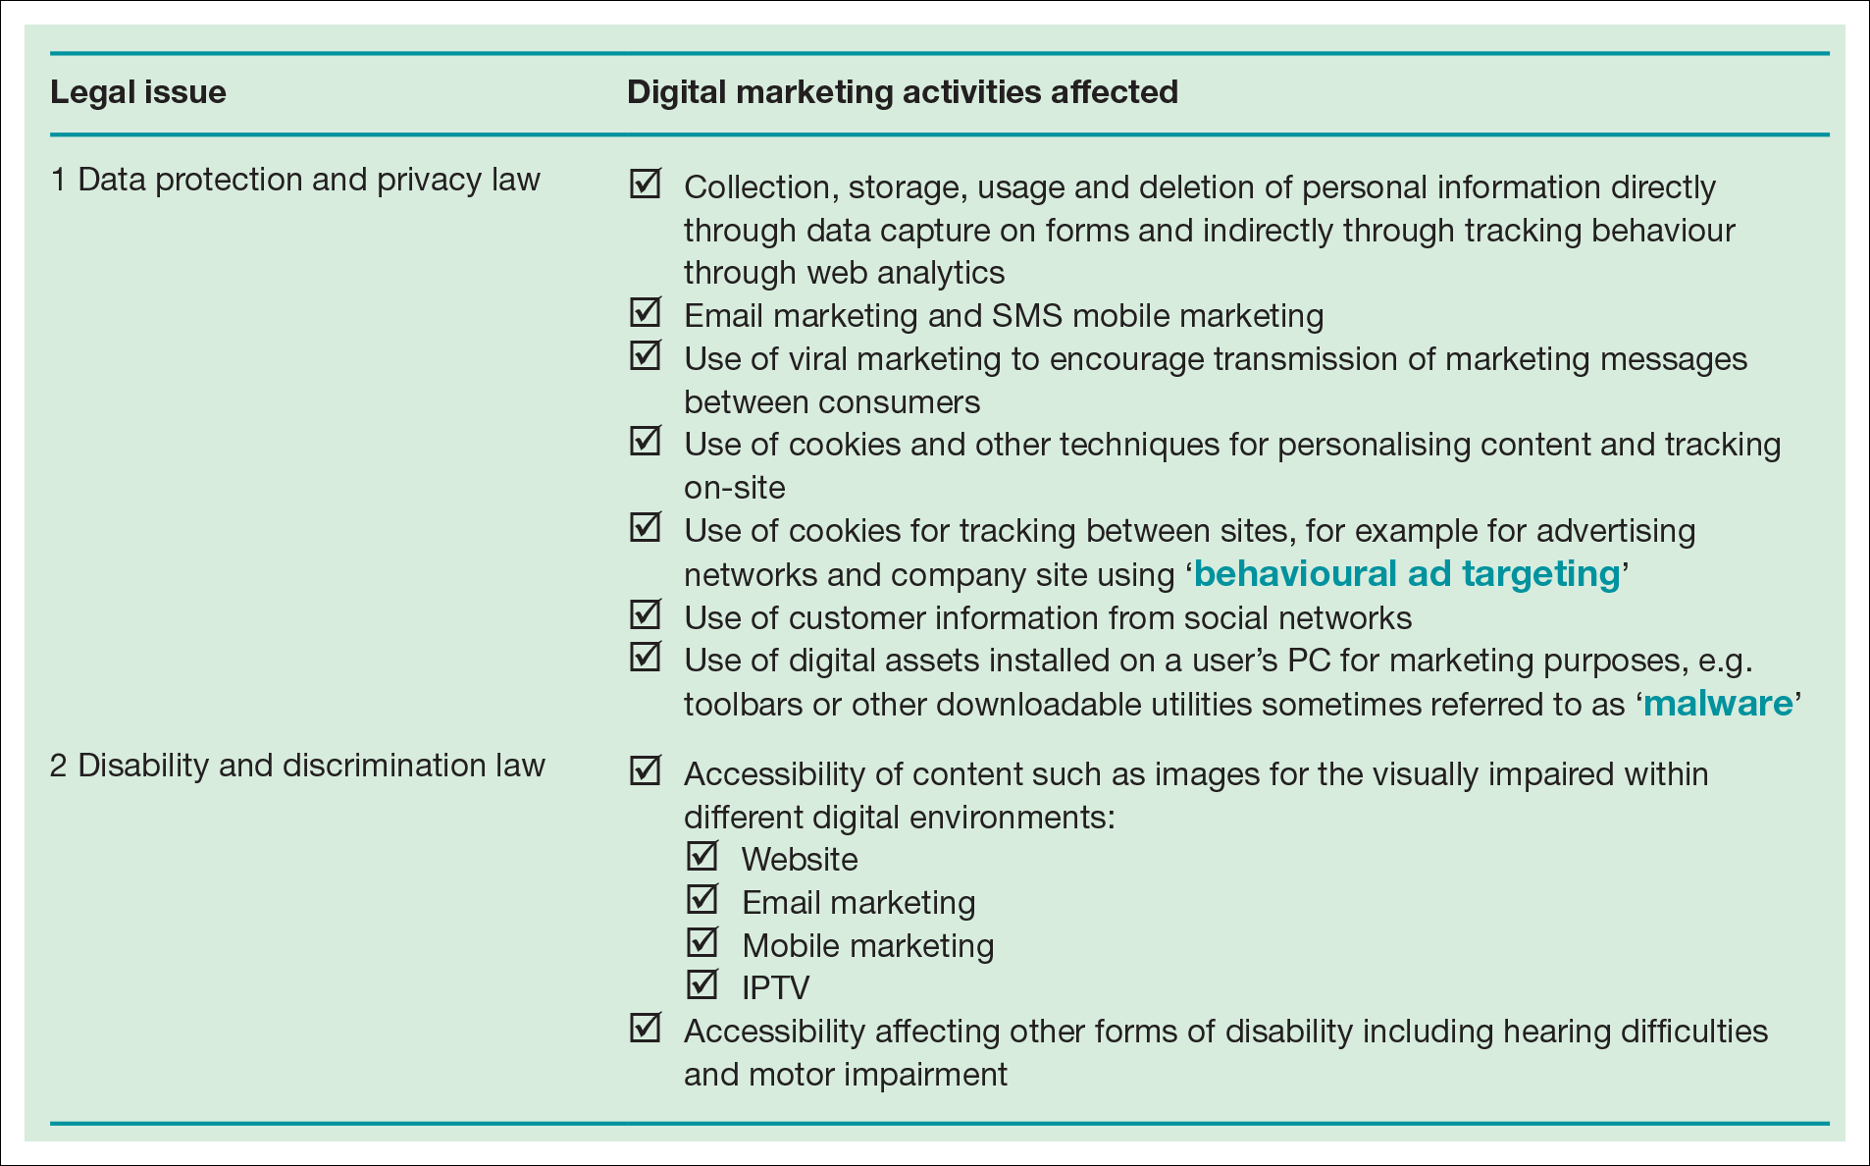
Table 4.2 Significant laws which control digital marketing

Slide 17
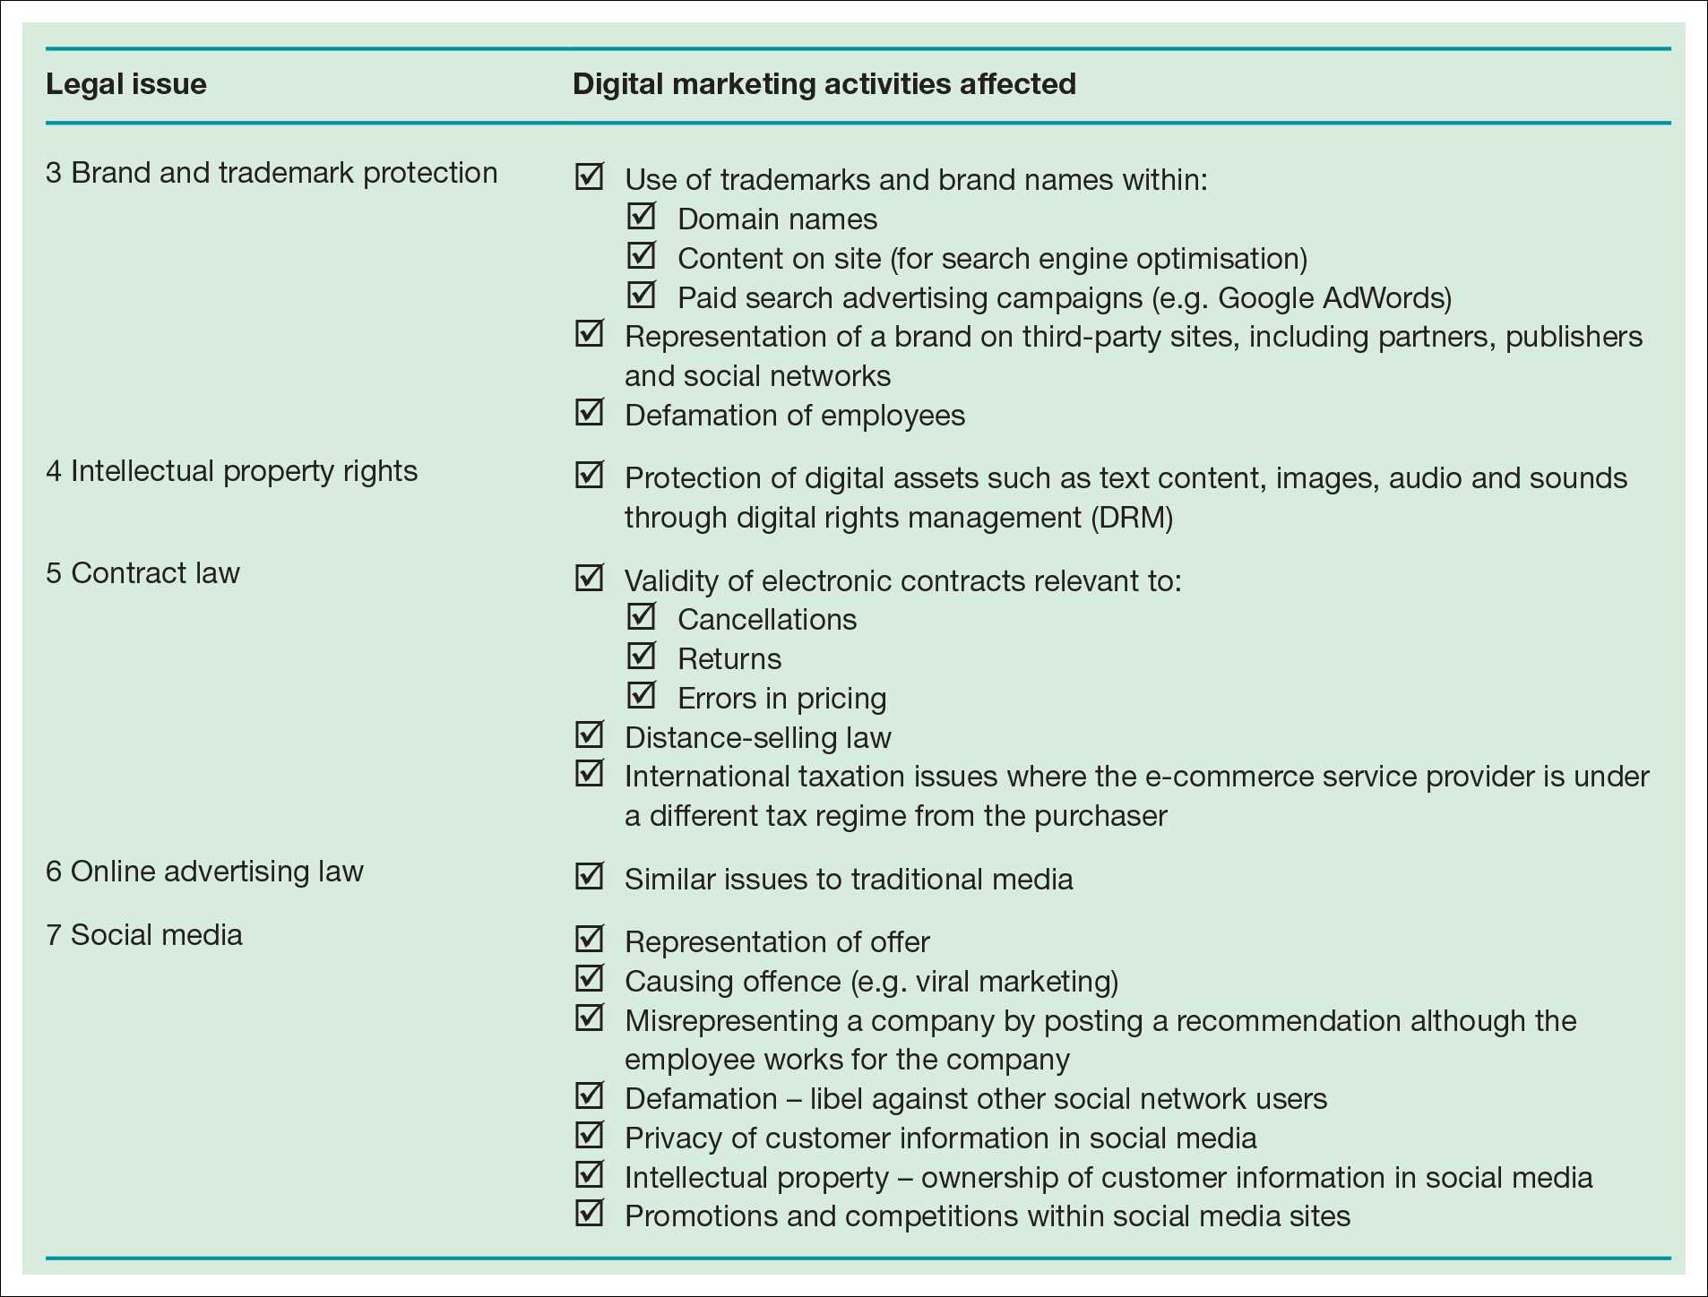
Table 4.2 Significant laws which control digital marketing (Continued)

Slide 18
Economic Factors
Variations in economic performance in different countries and regions affect spending patterns and international trade
Market growth and Employment
Inflation rate, Interest rates, Monitory/fiscal policies
Foreign exchange rate
A transactional e-commerce site uses algorithms to change the price of its products/services, based on market conditions, such as competitor pricing, supply and demand, spending habits, time of day, location. iPad browsers could pay more, because of expensive device.

Slide 19
Political Factors
An organisation needs to consider the political situation of a country and the world in relation to that country.
Government/leadership
Policies, Tax laws, Internal Governance
If an organisation goes for global marketplace and using social media, it is worth considering if there is any ban on social media sites.

Slide 20
Technological Factors
New technology is changing the way that people do things, from connecting with others to purchasing products and services.
Improvements in both hardware and software are key factors in this change
Mobile usage is overtaking desktop
Rate of change
Which new technologies should we adopt?
Monitoring for new techniques
Evaluation are we early adopters?
Re-skilling and training
Are our systems secure?

Slide 21
Other Factors - Culture
Social and cultural impacts of the Internet are important from an e-commerce perspective since they govern demand for digital services and propensity to purchase online and use different types of e-commerce services
Smartphones are changing the way people interact with companies, family and friends.

Slide 22
Other Factors – Factors affecting e-commerce buying behaviour
Credit card information being stolen – According to Canocchi(2017), in the UK, £124m was stolen by hackers and criminals. Encryption is the response
‘Fake’ online stores – Fear of buying from a virtual company with no address. Clear display of contact, official partner logos, reviews with Trustpilot are the responses.
Information will get sold, lost orders.
Unsure what the product is really like.
Need a help from a salesperson.

Slide 23
Other Factors – user’s access requirements
To fully understand online customer propensity to use an online service, we also need to consider the user’s access location, access device and webographics, which include:
Usage location from home or work
Access device, Connection speed
ISP - Internet Service Provider
Experience level, Usage type, Usage level

Slide 24
Other Factors – Consumers influenced by using the online channel
Online buyer behaviour – An assessment of how consumers and business providers use the internet in combination with other communications channels when selecting and buying products and services.
A global communications marketing firm(Edelman) produced a report ‘Trust Barometer’, showed that ‘Search Engines’ were the most trusted source for general news and information
Online influencers – predominantly young people, using social media to communicate their hobbies and interests
Zoella(Vlogger) in her 20s, has a following of 11.2m YouTube followers, where as BBC has 1.2m!
When Zoella paired up with Superdrug, her new range of beauty products, broke sales records within just 24 hours.

